Slide 1
IMDB reviews
Web scraping and sentiment analysis

Slide 2
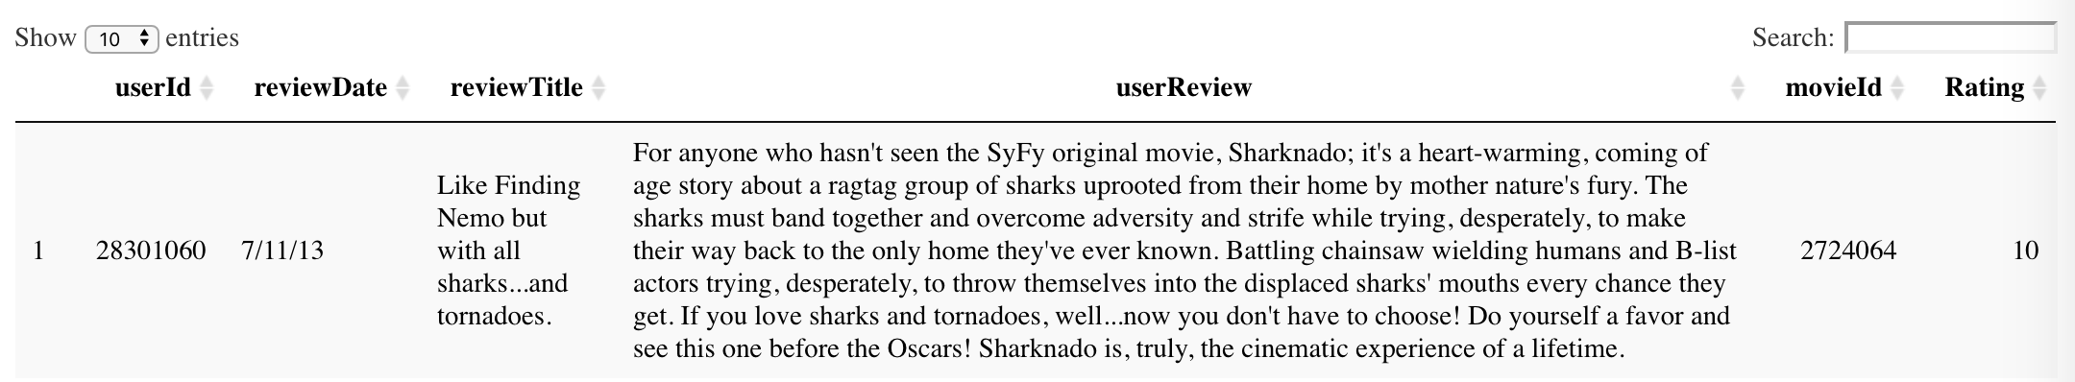
About the data
TV Movie: Released between 2011-01-01 and 2019-09-22
IMDB Advanced Search: Sorted by Number of Votes Descending
Dataset is not completed but enough to work with for now: 2437 TV Movies 17734 Reviews
Features: User id, movie id, review date, review title, review content and the raing
Example:

Slide 3
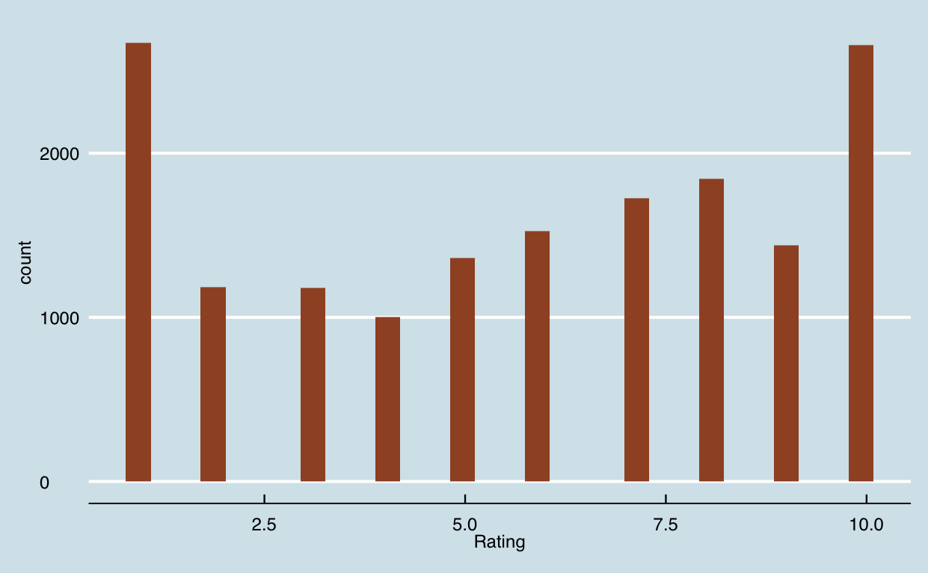
Explore the data
Distribution of the ratings
Longest review: (Rating = 10)
128 sentences (9.73 on average)
1635 words (158.61 on average)

Slide 4
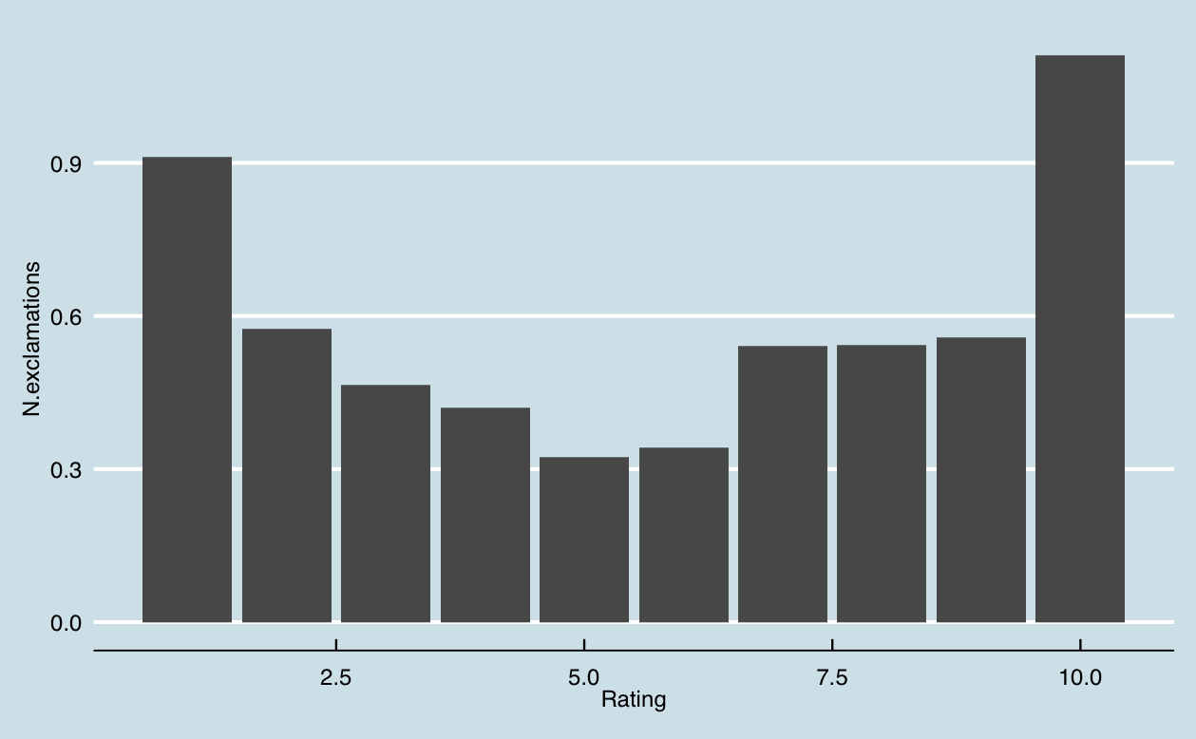
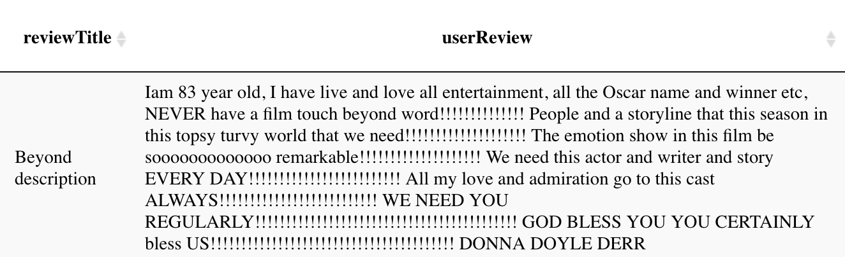
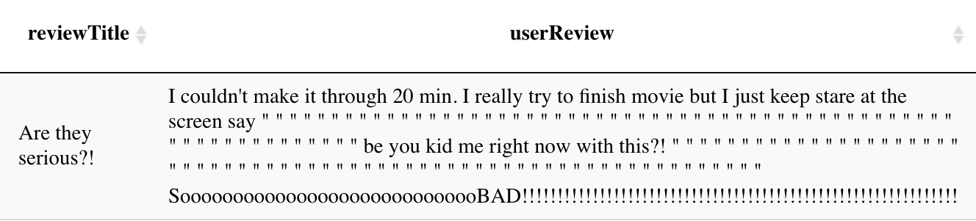
A flood of exclamation marks
Top 2:
1. Rating: 10 -- 188 exclamation marks
2. Rating: 1 -- 63 exclamation marks

Slide 5
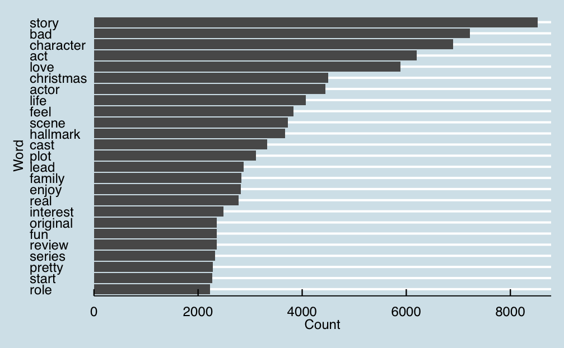

Common words
Top200Words movie film watch it's really don't seem never while lot i'm didn't something actually tv doesn't

Slide 6
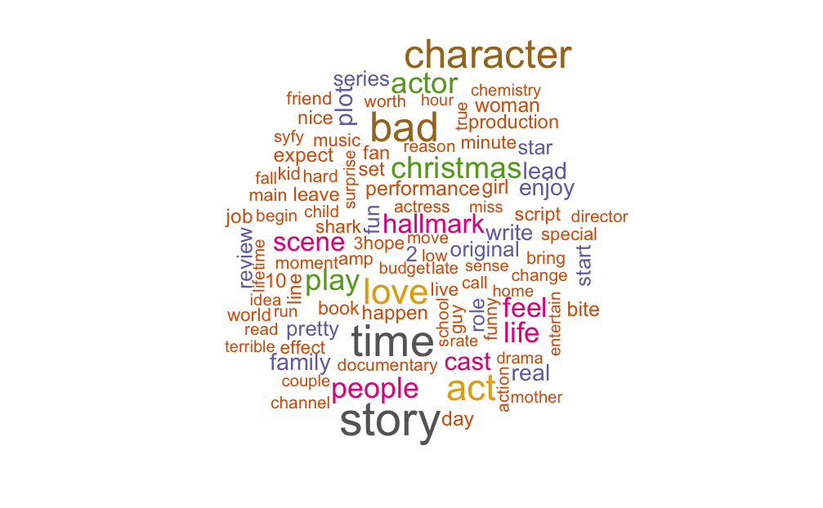
A word cloud

Slide 7
Common words among low ratings
Rating = 1
Rating = 2
Rating = 3
Rating = 4
Rating = 5
bad
bad
bad
story
story
act
act
character
character
character
character
character
story
bad
bad
story
story
act
act
act
actor
actor
actor
actor
feel
waste
plot
scene
scene
love
feel
nothing
feel
plot
hallmark
plot
scene
plot
lead
actor
original
feel
shark
feel
christmas
terrible
script
effect
christmas
scene
New
Existing

Slide 8
Common words among high ratings
Rating = 6
Rating = 7
Rating = 8
Rating = 9
Rating = 10
story
story
story
story
love
character
character
character
love
story
bad
christmas
love
character
character
christmas
love
christmas
life
life
act
act
act
christmas
christmas
love
review
enjoy
act
act
hallmark
life
hallmark
scene
hallmark
scene
hallmark
scene
feel
actor
feel
bad
feel
hallmark
feel
actor
actor
cast
actor
family
New
Existing

Slide 9
New features
act
character
story
actor
scene
script
christmas

Slide 10
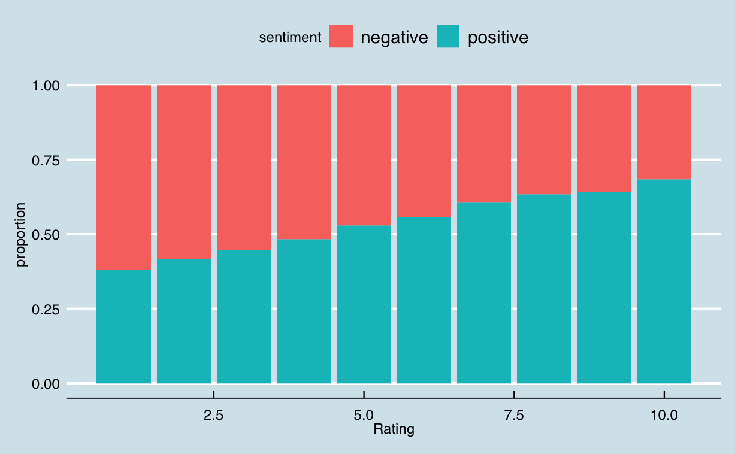
Sentiment Analysis
Positive / Negative
Correlation between
positive / negative words and rating
0.5197

Slide 11
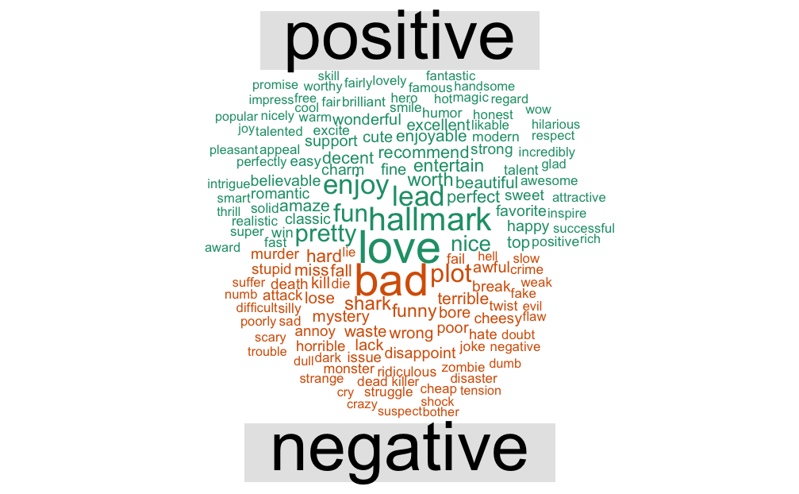
A comparison cloud

Slide 12
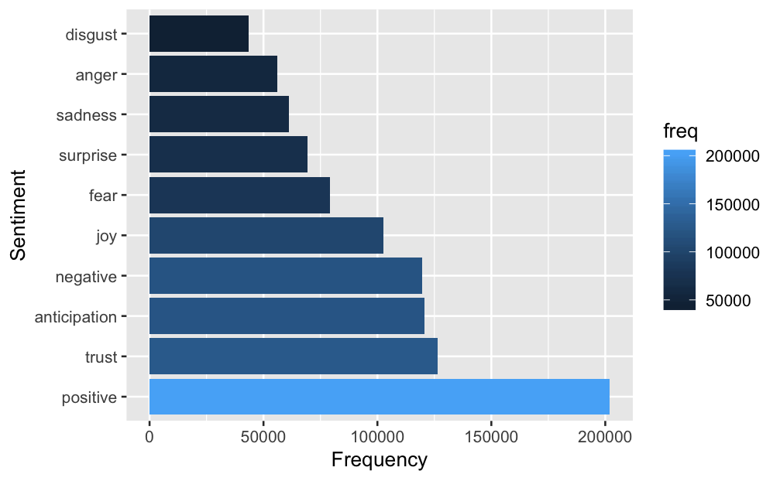
Sentiment Analysis
Chart of Words reflecting Emotion

Slide 13
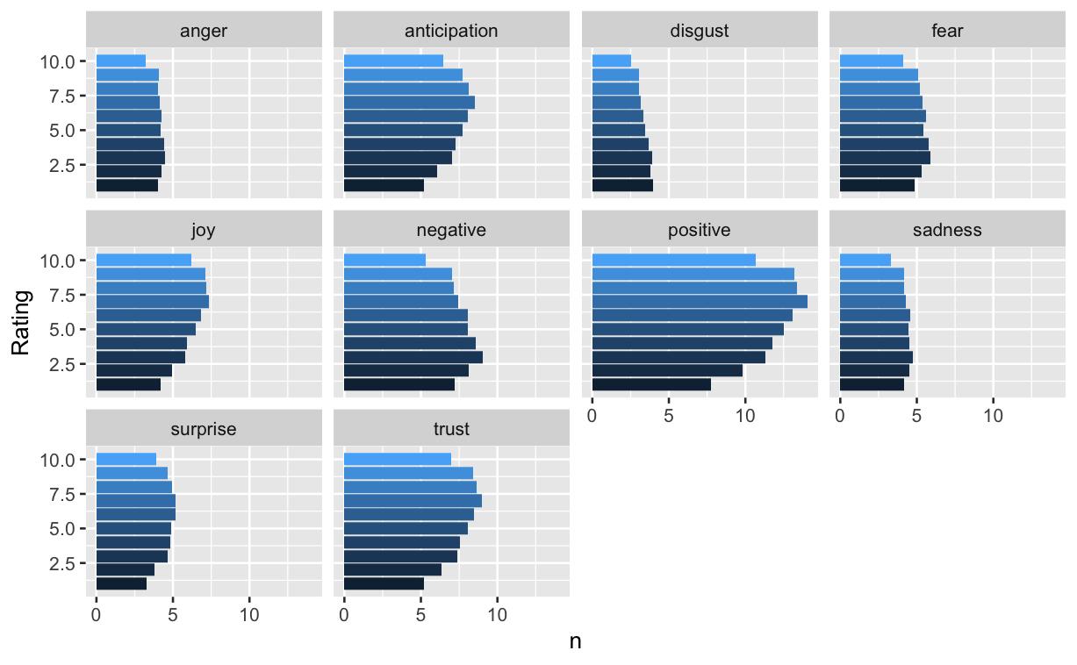
Sentiment Analysis
Different emotions among different ratings

